Slide 1
CS 488 Computer Networks and the Internet
Internet Architecture
(Layer cake and an hourglass)
(Portions Credit: Dr. Christo Wilson)
Updated 01/11/2019

Slide 2




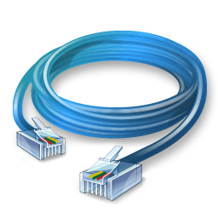



Problem Scenario
Web
Email
Bittorrent
VoIP
This is a nightmare scenario
Huge amounts of work to add new apps or media
Limits growth and adoption
Ethernet
802.11
Bluetooth
Cellular

